Slide 1
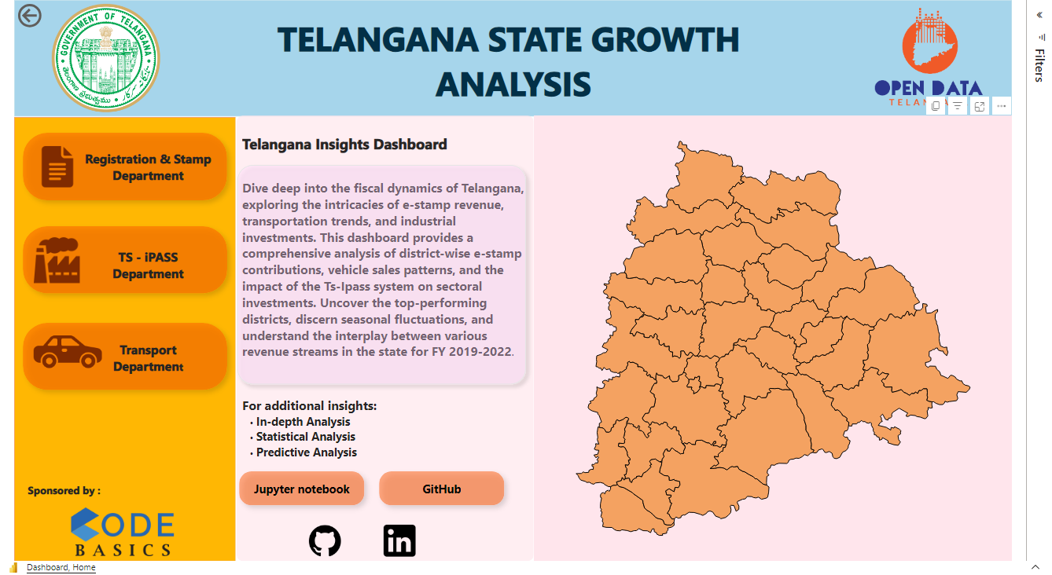

Slide 2

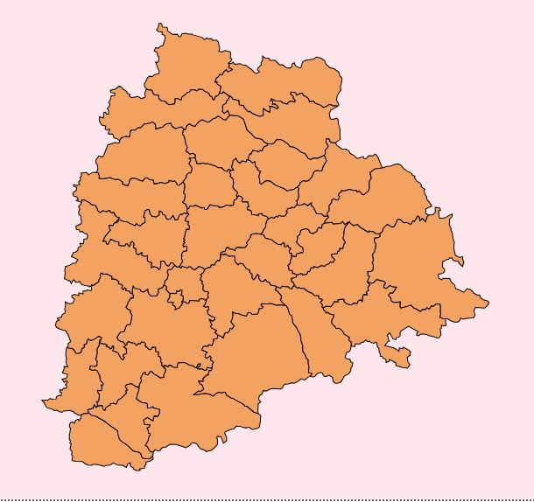






Click on logo follow Link
An Insightful Exploration of Stamp Registration, Transportation, and Ts-Ipass Datasets
Presented by: Naveen Kumar

Slide 3
Agenda
Stamps Registration
Transport Department
TS - iPASS
Stamp Registration
Exploration of Revenue Generation:
Analysis of revenue variation across districts.
Identification of top 5 districts with highest growth.
E-Stamp vs Document Registration:
Comparative analysis of revenue sources.
Insights into the impact of e-Stamp implementation.
Strategic Recommendations:
Suggestions for optimizing stamp registration processes.
Identifying areas for improvement and growth.
Transportation
Vehicle Sales Analysis:
Correlation between vehicle sales and specific months/seasons.
Insights into fuel-type category preferences.
District-wise Distribution:
Variation of vehicle classes across districts.
Identification of districts with specific vehicle preferences.
Growth Trends:
Top and bottom districts in vehicle sales growth.
Analysis of petrol, diesel, and electric vehicle trends.
Ts-Ipass
Investment Insights:
Identification of top sectors with significant investments.
Analysis of district-wise investment attraction.
Relationship Exploration:
Study of the correlation between investments, vehicle sales, and stamp revenues.
Insights into district and sector-specific trends.
Seasonal Patterns:
Analysis of investment trends across different months/seasons.
Identification of sectors with cyclic investment patterns.

Slide 4
Introduction
Background
Objective
Telangana’s Economic Landscape:
Telangana is one of the fastest-growing states in India, with an average annual growth rate of 13.90% over the last five years. The state's economy is diverse, with significant contributions from the service sector, agriculture, and industries.
Need for Analysis:
The state's rapid growth, fueled by sectors like IT and agriculture, necessitates an in-depth analysis of key datasets to understand the underlying trends, challenges, and opportunities.
Current Scenario:
With the state's GDP ranking 9th and a GDP growth of 11.2% in 2021-22, exploring datasets like Stamp Registration, Transportation, and Ts-Ipass can offer valuable insights to optimize growth strategies.
Data Exploration:
To delve into the intricate details of Stamp Registration, Transportation, and Ts-Ipass datasets, unraveling the attributes, categories, and time periods to derive actionable insights.
Trend Analysis:
To scrutinize the trends and patterns within each sector, aiming to unveil growth opportunities and areas that require attention and improvement.
Policy Impact:
To assess the influence of governmental policies and initiatives on these sectors, offering insights into their effectiveness and areas for enhancement.

Slide 5


Methodology & Data Sources
Tools Used :
Data Sources
The data is sourced from Open Data Telangana, an initiative by the Government of Telangana
MySQL: Served as the repository for data storage and management.
Jupyter Notebook: Applied for detailed reporting, advanced insights extraction, and predictive analysis.
Power BI: Facilitated interactive visualizations and concise insights sharing.
Datasets
Stamp Registration Data
Transportation Data
Ts-Ipass Data
Methodology
Data Collection & Data cleaning
Data Analysis & Statistical Analysis
Insight Generation & Dashboard

Slide 6

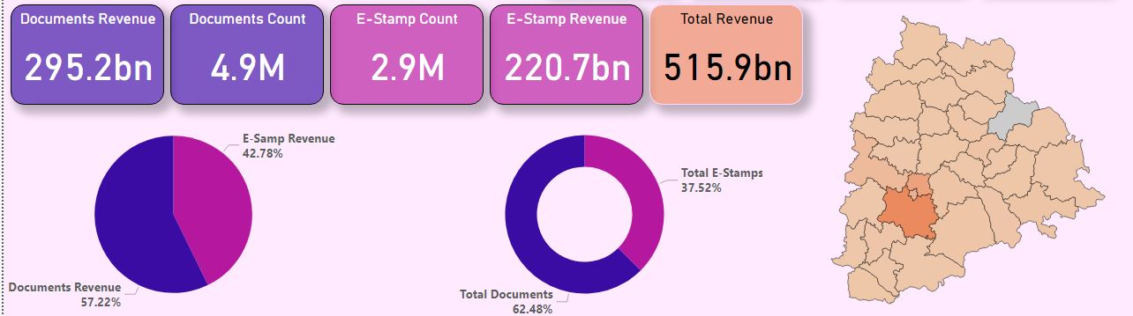
Stakeholder Problem
Statements
Our Approach
Data Integrity
Revenue Variation Across Districts
Document vs. E-Stamp Revenue
E-Stamp Challan Impact
District Categorization
Data Analysis
Visual Representations
Power BI, Jupyter Notebook
Strategic Recommendations
No data is available for September 2021
The 'Jayashankar Bhupalpally' district data is missing
Overall Summary :

Slide 7
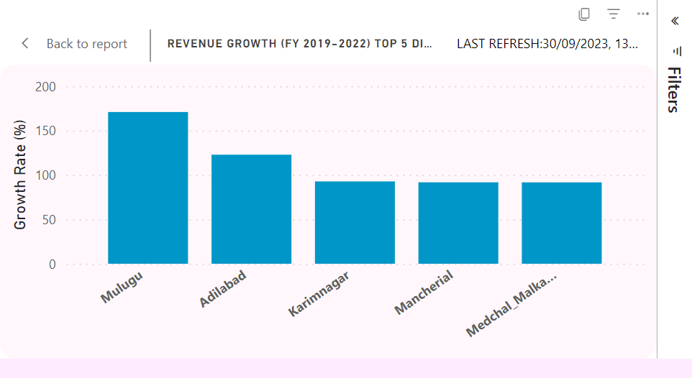
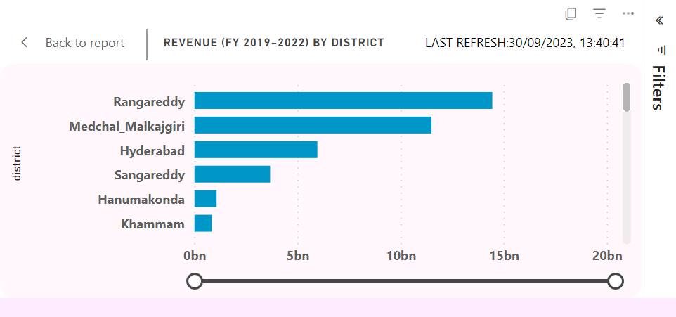
Revenue Growth (FY 2019-2022)
Top Revenue Districts:
Rangareddy: Tops with ₹1,081.99B revenue.
Medchal_Malkajgiri: Generates ₹640.71B.
Hyderabad: Capital city, earns ₹383.97B.
Sangareddy & Hanumakonda: Contribute ₹220.25B and ₹79.27B respectively.
Lowest Revenue Districts:
Kumurambheem Asifabad: Lowest, ₹227.46M.
Mulugu: Earns ₹515.53M.
Narayanpet: Generates ₹722.27M.
Warangal & Bhadradri Kothagudem: Make ₹738.34M and ₹824.71M respectively.
Top Districts by Growth Rate (2019-2022)
Mulugu: Despite its lower net revenue, Mulugu showed a massive growth rate of 170.94%.
Adilabad: This district followed closely with a growth rate of 122.84%.
Karimnagar and Mancherial: These districts also exhibited significant growth rates of 92.75% and 91.75%, respectively.
Medchal_Malkajgiri: This district, being one of the top revenue generators, also showed a commendable growth rate of 91.68%.

Slide 8
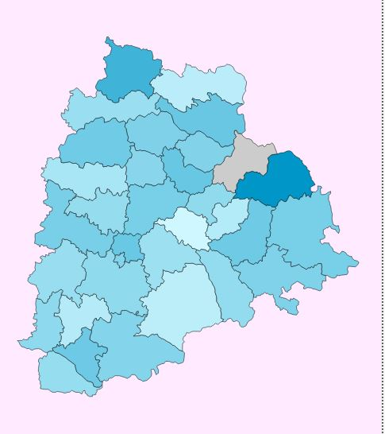
Revenue Growth (FY 2019-2022)
Analysis & Recommendations
Urban Centers Thrive
Rangareddy, Medchal_Malkajgiri, and Hyderabad generate massive revenues due to their urbanization and proximity to Hyderabad, leading to higher document registrations.
Growth Opportunities
Mulugu and Adilabad have lower revenues but show significant growth, indicating untapped development and investment potentials.
Addressing Low Performers
Kumurambheem Asifabad and Mulugu require attention to understand and address their lower performance, potentially linked to less urbanization or socio-economic factors.
Data-Driven Strategies
This revenue data is crucial for the government and investors to strategize investments and development plans effectively.
Conclusion
Revenue insights reveal economic activities and district development levels. Urban districts are thriving, while others show growth potential. Strategic investments, informed by this data, can enhance district development.
Note: All figures are approximate.

Slide 9
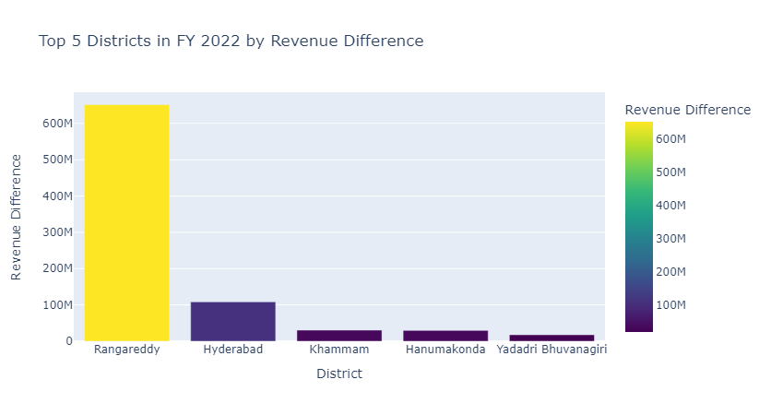
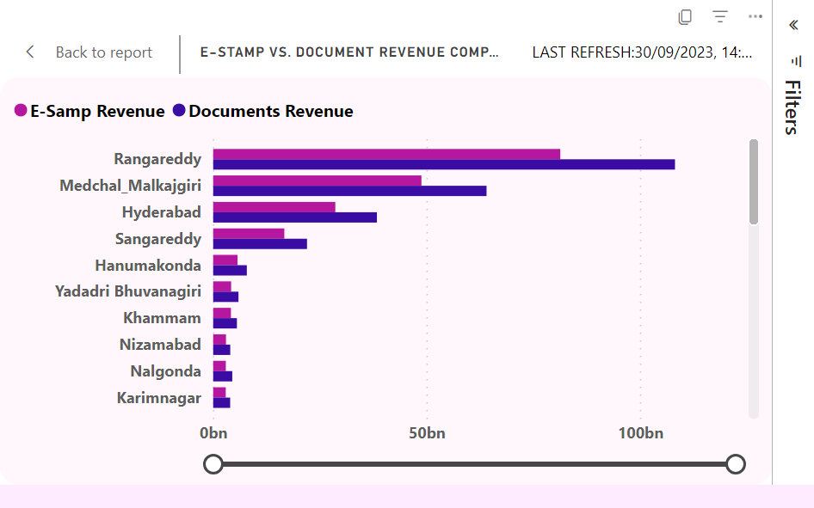
E-Stamp vs. Document Revenue Comparison FY 2022
Top 5 Districts in FY 2022:
The districts where e-stamp revenue was significantly higher than document registration revenue are:
Rangareddy: With a difference of approximately 651.6 million.
Hyderabad: With a difference of approximately 108.3 million.
Khammam: With a difference of approximately 30.6 million.
Hanumakonda: With a difference of approximately 29.6 million.
Yadadri Bhuvanagiri: With a difference of approximately 17.8 million.

Slide 10
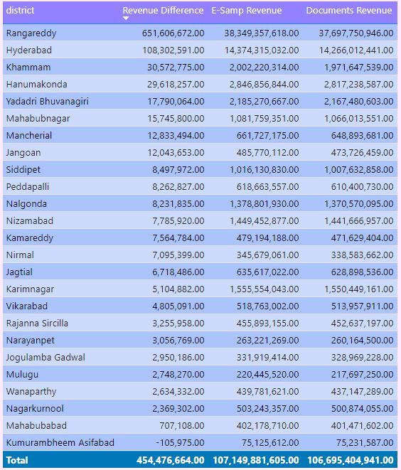
E-Stamp vs. Document Revenue Comparison FY 2022
Insights from External Source:
From the information gathered from Wikipedia regarding the districts of Telangana:
Rangareddy: This district surrounds the city of Hyderabad, the state capital. It is a major hub for IT companies and has seen rapid urbanization. The high e-stamp revenue might be attributed to the increasing number of property transactions and business activities in this district.
Hyderabad: Being the capital city and a major IT and business hub, it's not surprising that Hyderabad has a significant e-stamp revenue. The city witnesses a high number of property and business transactions.
Khammam, Hanumakonda, and Yadadri Bhuvanagiri: These districts, while not as urbanized as Hyderabad or Rangareddy, have their own economic activities and growth factors contributing to the e-stamp revenue.
Conclusion:
The analysis provides a clear picture of the revenue streams from document registration and e-stamp challans across districts in Telangana for FY 2022. While document registration remains a major revenue source, certain districts like Rangareddy and Hyderabad have seen a significant contribution from e-stamp challans. The external information further justifies the insights, indicating the economic growth and urbanization factors in these districts. It would be beneficial for policymakers and stakeholders to focus on these districts for further development and revenue generation opportunities.

Slide 11
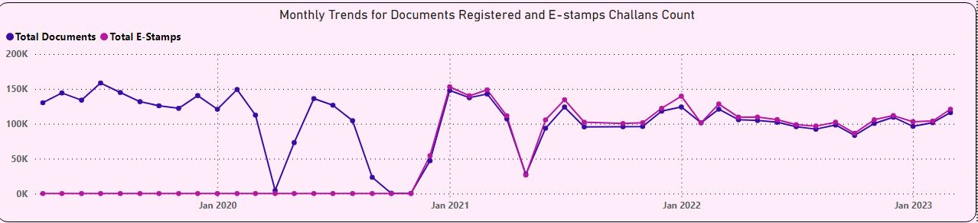
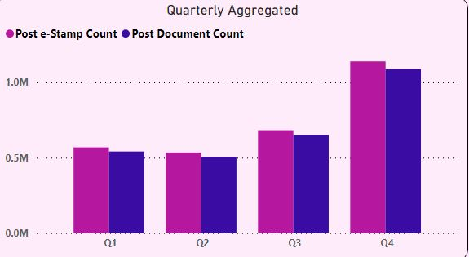
Document and e-Stamp Trends Post e-Stamp Implementation
E-Stamp Challan Implementation Impact Report
Introduction: The e-Stamp system, initiated on December 1, 2020, simplified document registration.
Key Observations:
1. Trends:
Annual peaks in registrations during December-January.
A notable decline in May 2021.
2. Post-Implementation:
Steady e-Stamp adoption; by 2022, it slightly surpassed document registrations.
A 75% increase in the combined count of both metrics.
3. Growth:
Consistent yearly growth, with a spike in the fourth fiscal quarter.
Conclusion: E-Stamp introduction boosted document registrations. Ongoing trend analysis and Q4 targeted promotions are recommended.

Slide 12
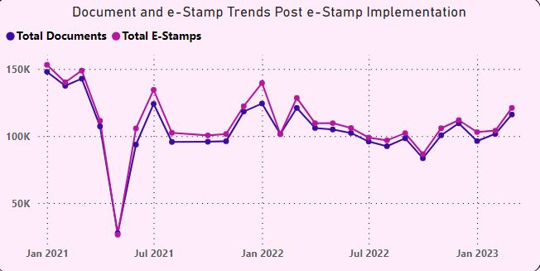
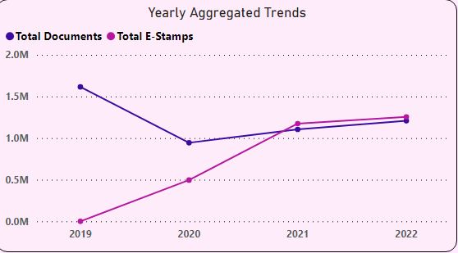
Document and e-Stamp Trends Post e-Stamp Implementation
Recommendations for the Government
1. Data Integrity: Investigate the data void in September 2021 to ensure the accuracy and reliability of the data.
2. Promotion of E-Stamp System: Given the robust correlation between e-Stamp adoption and document registrations, the government should contemplate promoting the e-Stamp system more aggressively, especially during peak registration periods.
3. Integration: The government could mull over further amalgamating the e-Stamp system with document registration, given their strong correlation. This could simplify the process and enhance user experience.
4. Public Awareness: Launch public awareness campaigns, especially targeting rural areas, to educate the masses about the benefits and ease of using e-Stamp challans.
5. Expand E-stamping Services: Consider expanding e-stamping services to other domains, making it more versatile and comprehensive.
6. Integration with Other Services: Meld e-stamping with other governmental services, like property registration, to offer a seamless experience to users.
7. Analyze Underperforming Districts: Conduct a thorough analysis of districts that have shown less enthusiasm towards the e-Stamp service. Understand the challenges and work towards addressing them.
8. Continuous Monitoring: While the current data doesn't show a significant decline in document registrations post e-Stamp implementation, it's vital to keep a close watch on the trends to address any future declines promptly.
By implementing these recommendations, the government can ensure that the e-Stamp system continues to benefit the public and contributes positively to the administrative processes.

Slide 13
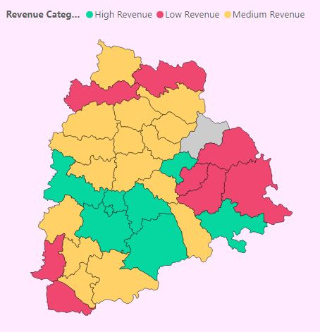
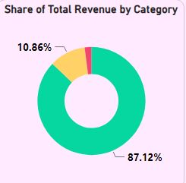
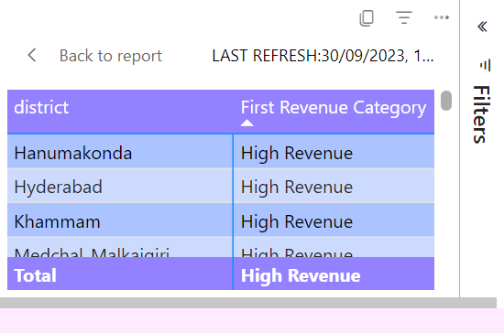
District Revenue Segmentation: FY 2021-2022
High Revenue Districts
Districts: Rangareddy, Medchal_Malkajgiri, Hyderabad, Sangareddy, Yadadri Bhuvanagiri, Hanumakonda, Khammam, and Karimnagar.
Medium Revenue Districts
Districts: Adilabad, Jagtial, Jangoan, Kamareddy, Mahabubnagar, Mancherial, Medak, Nagarkurnool, Nalgonda, Nizamabad, Peddapalli, Rajanna Sircilla, Siddipet, Suryapet, Vikarabad, and Wanaparthy.
Low Revenue Districts
Districts: Bhadradri Kothagudem, Jogulamba Gadwal, Kumurambheem Asifabad, Mahabubabad, Mulugu, Narayanpet, Nirmal, and Warangal
High Revenue Districts
Urban areas like Rangareddy, Medchal, and Hyderabad, driven by IT and construction sectors, generated 87.2% of the 2021-2022 revenue, totaling 334,438.3 million. Rapid urbanization and investments, including in emerging areas like Yadadri, are notable.
Medium Revenue Districts
Rural districts, reliant on agriculture and characterized by land and natural resources, contributed 10.8% to the revenue, totaling 41,483.1 million in 2021-2022.
Low Revenue Districts
Areas like Bhadradri Kothagudem, rich in forests and natural resources but with low population density, contributed 2% to the revenue, totaling 766.5 million in 2021-2022.
Segmentation Criteria Definition
High Revenue Districts: Districts generating revenue above the 75th percentile.
Medium Revenue Districts: Districts generating revenue between the 25th and 75th percentile.
Low Revenue Districts: Districts generating revenue below the 25th percentile.

Slide 14
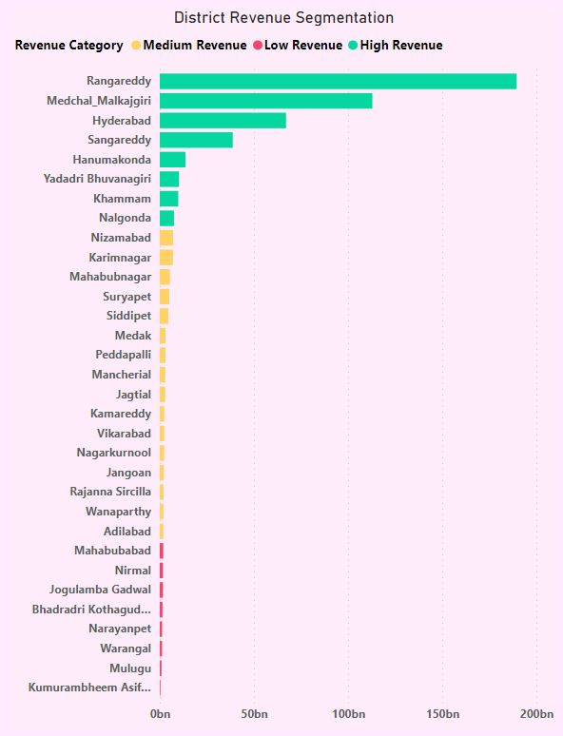
District Revenue Segmentation: FY 2021-2022
Key Insights
Rangareddy District: This district alone contributes a whopping 36.56% of the revenue, highlighting its significance in the state's economy.
Hyderabad: The capital city follows closely, contributing 13.10% to the revenue.
Medchal Malkajgiri: Another major contributor with a share of 22.05%.
Conclusion
The revenue generation analysis provides valuable insights into the economic dynamics of the districts. While urbanized areas contribute significantly to the revenue, the potential in rural districts remains largely untapped. Strategic development initiatives and investments in these areas can lead to a more balanced economic growth across the state.
Recommendations
Infrastructure Development
Enhance infrastructure in Medium and Low Revenue Districts to attract businesses and boost revenue.
Promote Agriculture
With many districts having an agricultural base, introducing modern farming techniques and providing subsidies can enhance productivity and revenue.
Tourism Development
Districts rich in natural resources and forests, especially those in the Low Revenue category, can be developed as tourist spots, generating additional revenue.
Awareness Campaigns
Conduct awareness campaigns in Medium and Low Revenue Districts about the benefits of e-stamp challans and document registration to increase transactions.

Slide 15

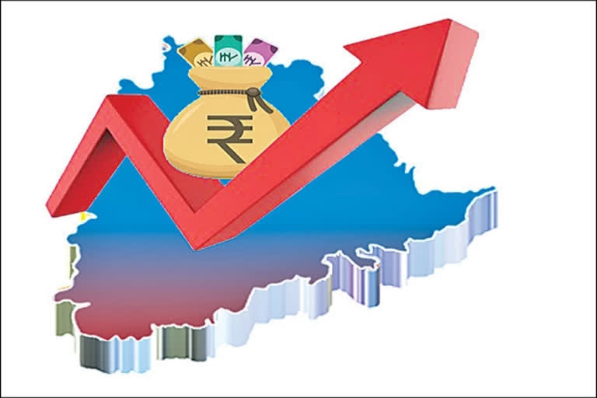



Top 5 Insights and Recommendations in Stamps & Registration

Slide 16
Urbanization and Proximity to Capital
Districts in close proximity to the capital city, Hyderabad, like Rangareddy and Medchal_Malkajgiri, have shown significant revenue generation from document registration and e-stamp challans, highlighting the impact of urbanization on revenue generation.

Slide 17
Potential Growth in Low Revenue Districts
Despite low net revenue, districts like Mulugu and Adilabad exhibited high growth rates, indicating an untapped potential for development and investment.

Slide 18
E-stamp Implementation
The implementation of the e-Stamp challan system has positively impacted document registrations with a robust linear correlation between the two metrics, indicating the simplification in the registration process.

Slide 19
Seasonal Trends
Document registration and e-stamp challan counts exhibit seasonal trends with noticeable peaks at the onset of each year, especially during December and January.

Slide 20
Revenue Contribution
The significant contribution of revenue from high revenue districts like Rangareddy, Hyderabad, and Medchal Malkajgiri emphasizes their importance in the state’s economy

Slide 21
Enhance infrastructure in Medium and Low Revenue Districts.
Recommendations
Promote the e-stamp system during peak periods.
Modernize agriculture in rural districts.
Promote tourism in resource-rich districts.
Conduct public awareness campaigns in Medium and Low Revenue Districts.

Slide 22
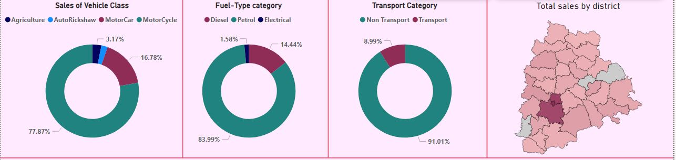
Stakeholder Problem
Statements
Our Approach
Data Integrity
Correlation Between Vehicle Sales and Seasons
Vehicle Distribution by Class
Vehicle Sales Growth Comparison
Data Analysis
Visual Representations
Power BI, Jupyter Notebook
Strategic Recommendations
Absence of data for Hanumakonda, Narayanapet, and Mulugu districts, raising concerns about the completeness and accuracy of the overall dataset.
Overall Summary :

Slide 23
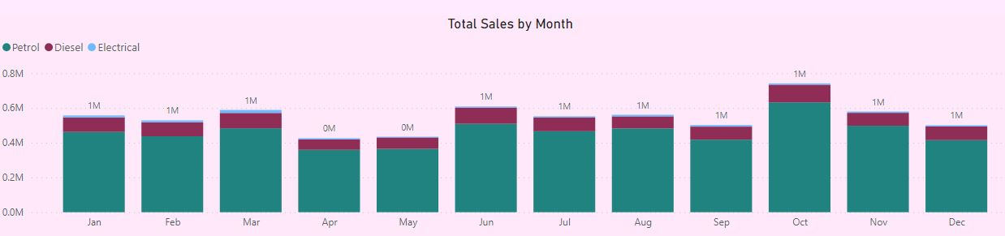
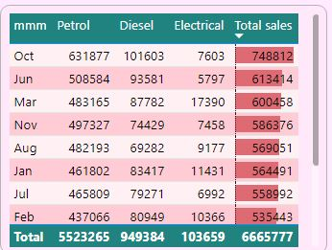
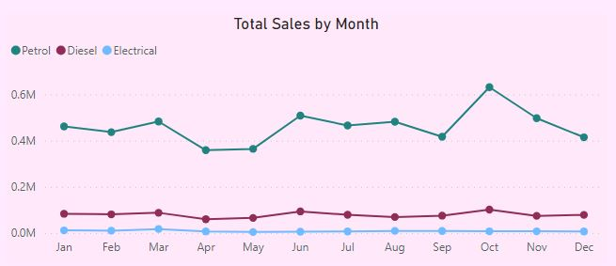
Seasonal Correlation of Vehicle Sales
Monthly Sales Trend Analysis
1. Peak Sales in October:
Consistent highest sales recorded.
Boosted by Dussehra and Diwali offers.
2. Sales Dip in November-December:
Decline due to vehicle make year concerns.
Consumers await next year's make for better resale value.
3. Sales Rebound in January:
A resurgence observed, maintaining an upward trend till the next October.
4. Anomalies Identified:
Significant sales drop in April 2020 and May 2021.
Attributed to COVID-19 lockdowns impacting sales.

Slide 24
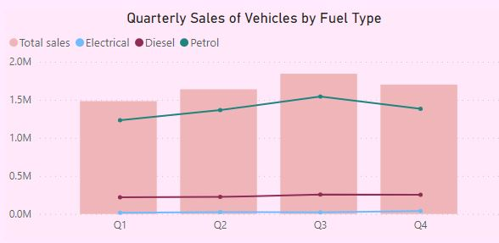
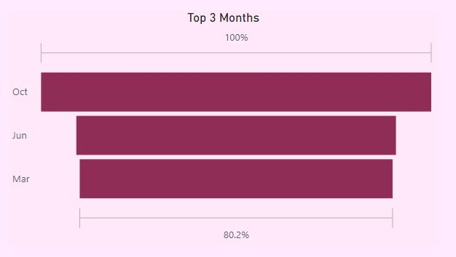
Seasonal Correlation of Vehicle Sales
Recommendations:
Festive Season Promotions:
Capitalize on high October sales with enhanced festive offers and campaigns.
Post-Festive Strategy:
Introduce end-of-year sales to counter the November-December sales dip.
Electric Vehicle Push:
Amplify electric vehicle promotions during low sales months.
Consumer Feedback:
Conduct surveys in fluctuating sales districts for insights on local preferences.
Vehicle Make Year Awareness:
Educate on pros and cons of purchasing timing related to make year.
Conclusion:
Peak Sales: Pronounced sales peak in October due to festive seasons and buying patterns.
Sales Dip: Notable decline post-October, opportunity for targeted promotions.
Electric Vehicles: Emerging preference noted, indicating a market shift.
Data Gaps: Absence of data for key districts needs addressing for comprehensive analysis.

Slide 25
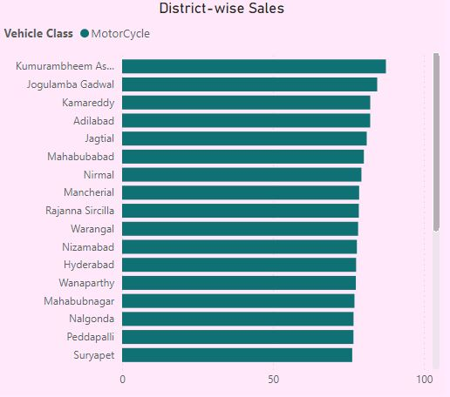
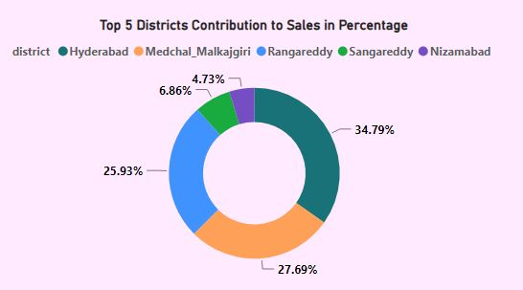
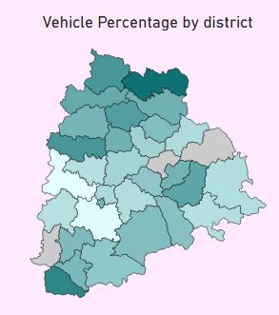
Vehicle Class Distribution by District FY 2022
MotorCycle
Preference Analysis:
1. High Preference Districts:
Districts: Jogulamba Gadwal, Jagtial, Kumurambheem Asifabad.
Preference: Strong inclination towards motorcycles.
Reason: Economical and flexible transportation needs.
2. Hyderabad Anomaly:
Observation: Despite being a metro city, Hyderabad favors motorcycles.
Reason: Dense traffic conditions favoring two-wheelers' maneuverability.
3. Statewide Trend:
Insight: Slight higher motorcycle preference in these districts, aligning with a general state-wide trend.
Analysis: The difference isn’t statistically significant, indicating a universal preference.
Sales Distribution Insights:
- Dominant in districts like Hyderabad, Medchal Malkajgiri, Rangareddy, Sangareddy, and Nizamabad, accounting for 83% of overall sales.
- Factors influencing this distribution include urbanization, high population density, and the presence of industries.

Slide 26
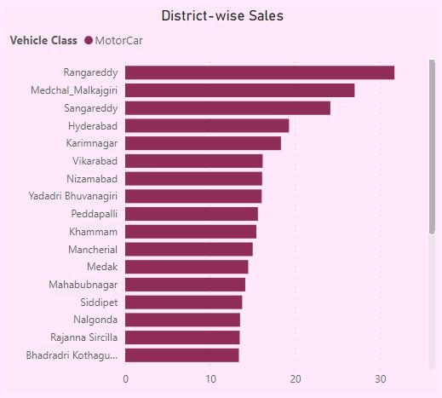
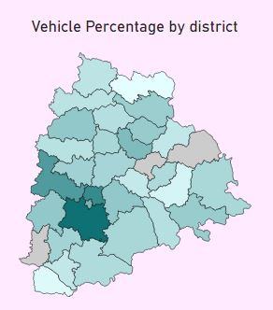
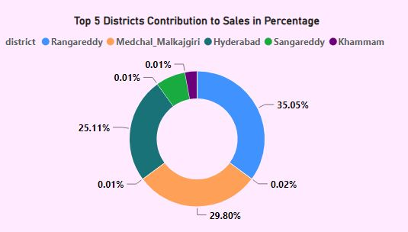
Vehicle Class Distribution by District FY 2022
MotorCar
Preference Analysis:
1. Urban Preference:
Districts: Rangareddy and Medchal Malkajgiri.
Trend: Higher car preference.
Reason: Proximity to Hyderabad indicates higher purchasing power and urban living preferences.
2. Contrast with Hyderabad:
Observation: Neighboring districts favor cars, contrasting with Hyderabad’s motorcycle preference.
Insight: Indicates a pattern of residing in suburbs and commuting to the city.
3. Nizamabad's Trend:
Observation: Significant car preference, despite not being as urbanized as Hyderabad.
Analysis: Regional economic or urbanization trends influence vehicle choices.
Sales Distribution Insights:
- Predominantly found in Rangareddy, Medchal Malkajgiri, Hyderabad, Sangareddy, and Khammam, contributing to 85% of sales.
- Hyderabad ranks third, suggesting a preference for motorcycles over cars, possibly due to traffic congestion.

Slide 27
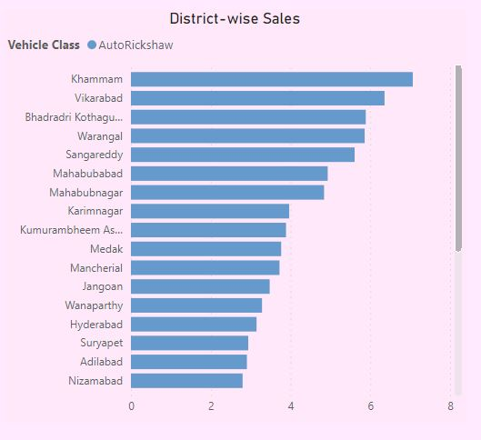
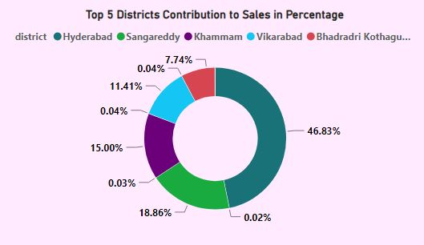
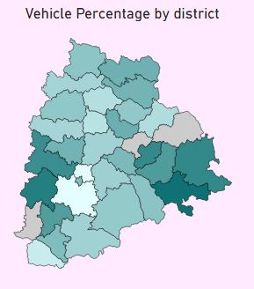
Vehicle Class Distribution by District FY 2022
AutoRickshaw
Preference Analysis:
Top Districts: Khammam and Vikarabad lead in the preference for AutoRickshaws, possibly indicating the significance of shared mobility or the presence of commercial activities requiring short-distance transportation.
Shared Mobility Indicator: A higher percentage of AutoRickshaws could hint towards fewer personal vehicle ownerships and a reliance on public or shared transport.
Sales Distribution Insights:
- Major sales are observed in Hyderabad and Sangareddy, making up 51% of total sales.
- Medchal and Rangareddy rank lower, which may require further investigation given their urbanized nature.

Slide 28
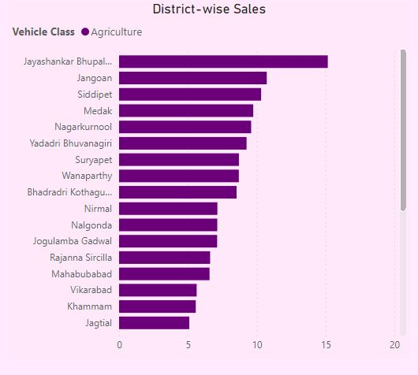
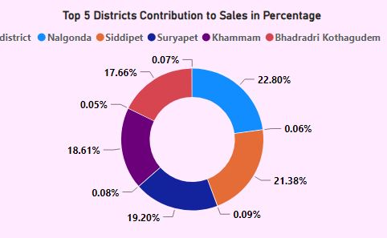
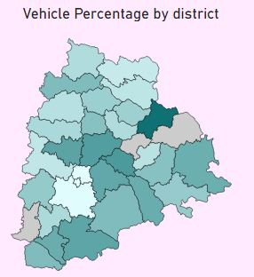
Vehicle Class Distribution by District FY 2022
Agriculture
Preference Analysis:
Agricultural Dominance: Districts like Jayashankar Bhupalpally and Jangoan have a higher preference for agriculture-related vehicles, indicating the dominance of agricultural activities.
Rural Landscape: A higher preference for agriculture vehicles might suggest a more rural landscape with farming as a primary occupation.
Infrastructure Insights: These districts might require better roads suitable for tractors and other agricultural machinery, indicating a need for infrastructure planning.
Sales Distribution Insights:
- Districts like Nalgonda, Siddipet, Suryapet, and Khammam lead in agricultural vehicle sales, with each district contributing around 12%.
- The sales distribution reflects the agricultural nature of these districts.

Slide 29
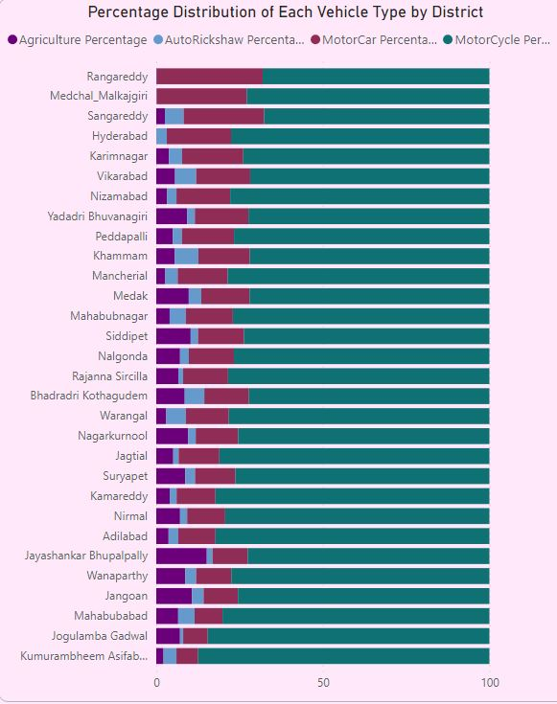
Vehicle Class Distribution by District FY 2022
Recommendations
Targeted Marketing: Manufacturers and dealers should focus on targeted marketing campaigns. For example, MotorCars can be promoted more in Rangareddy due to the existing preference.
Infrastructure Development: Local authorities should consider these findings when planning infrastructure. Districts with a higher number of MotorCycles and AutoRickshaws might require different traffic management strategies.
Further Study: A deeper dive into the reasons behind these preferences can provide more actionable insights. Factors like socio-economic conditions, local industries, and road conditions might influence vehicle preferences.
Data Verification: Given the unexpected findings in districts like Medchal and Rangareddy for AutoRickshaw sales, it might be worthwhile to verify the data sources or delve deeper into external factors that might be influencing these numbers.
Promote Public Transportation: In areas like Hyderabad, where motorcycles are preferred due to traffic congestion, local authorities might consider enhancing public transportation options to alleviate congestion and promote sustainable modes of transport.
Agricultural Subsidies: In districts with a high preference for agricultural vehicles, the government might consider introducing subsidies or incentives to promote modern farming techniques and equipment.
Conclusion
The distribution of vehicles across different districts varies significantly based on vehicle class. While some districts show a clear preference for a particular vehicle type, others follow the overall trend. Understanding these preferences can guide both manufacturers in their marketing strategies and local authorities in their infrastructure planning. Further studies can provide deeper insights into the reasons behind these preferences, leading to more informed decisions.

Slide 30
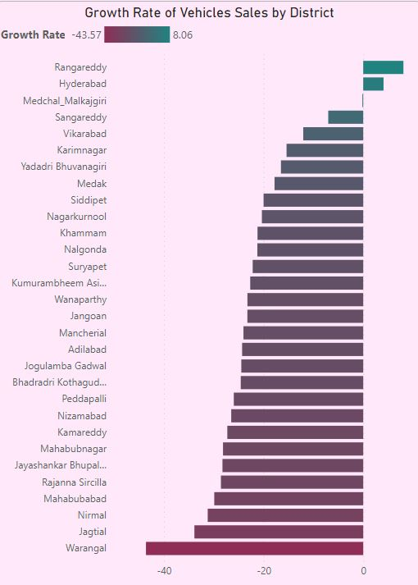
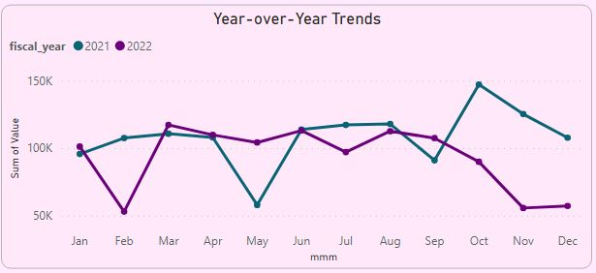
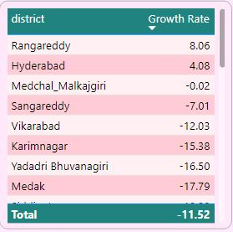
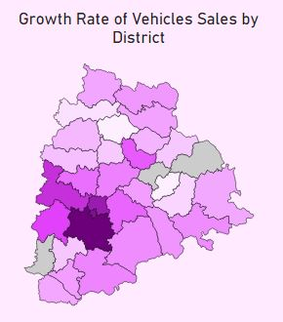
Vehicle Sales Growth Comparison FY 2022 - 2021
Petrol
Top Growth:
Rangareddy: 8.73%
Hyderabad: 1.03%
Medchal_Malkajgiri: -0.90%
Lowest Growth:
- Warangal: -45.32%
- Nirmal: -41.05%
- Jagtial: -40.53%

Slide 31
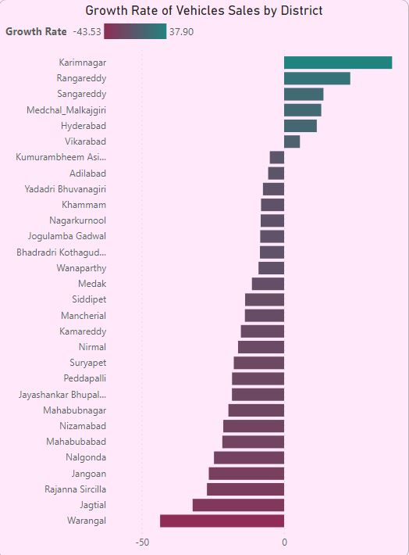
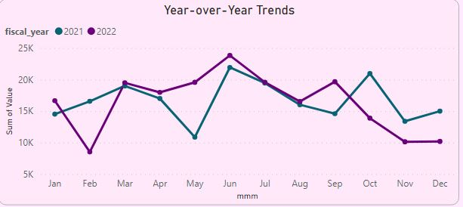
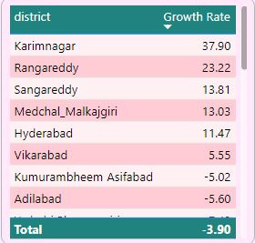
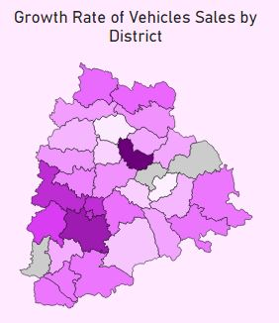
Vehicle Sales Growth Comparison FY 2022 - 2021
Diesel
Top Growth:
- Karimnagar: 111.44%
- Sangareddy: 13.21%
- Rangareddy: 12.67%
Lowest Growth:
Warangal: -48.03%
Mahabubabad: -24.29%
Jangoan: -21.99%

Slide 32
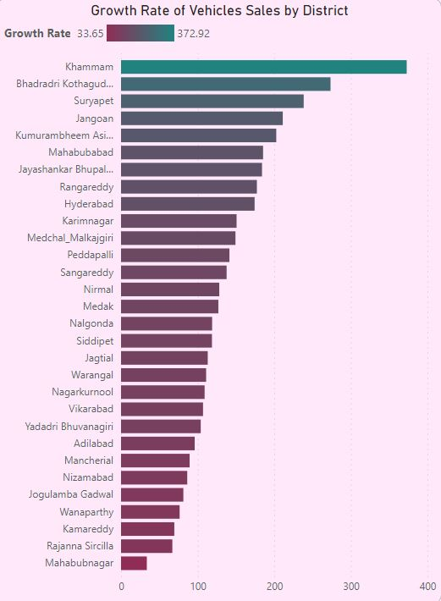
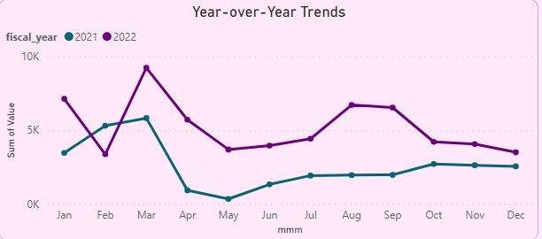
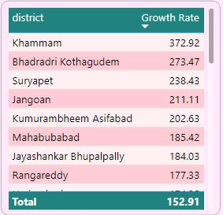
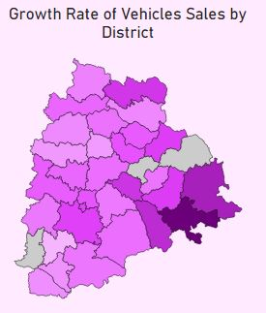
Vehicle Sales Growth Comparison FY 2022 - 2021
Electrical
Top Growth:
Khammam: 409.40%
Bhadradri Kothagudem: 281.58%
Suryapet: 247.15%
Lowest Growth:
Wanaparthy: 5.48%
Rajanna Sircilla: 14.92%
Mancherial: 19.19%

Slide 33
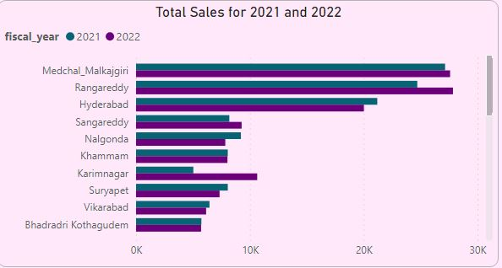
Vehicle Sales Growth Comparison FY 2022 - 2021
Additional Insights:
Electric Vehicle Surge: Notable growth in districts, driven by environmental awareness and incentives.
Fuel Type Variability: Diesel sales surge in some areas, decline in others, hinting at the impact of fuel prices or clean energy policies.
Urban vs. Rural Resilience: Urban areas like Hyderabad show adaptability to changing vehicle trends.
Additional Recommendations:
Promote Electric Vehicles: Enhance incentives and awareness campaigns to boost EV adoption.
Study External Factors: Analyse the decline in traditional fuel vehicles, considering fuel prices and local policies.
Targeted Marketing: Utilize district-wise trends for tailored marketing and inventory strategies.
FY 2022 Top Sales:
Hyderabad: 271K
Rangareddy: 242K
Medchal: 241K
Sangareddy: 62K
Khammam: 40K
FY 2021 Top Sales:
Hyderabad: 259K
Medchal: 236K
Rangareddy: 215K
Sangareddy: 63K
Nizamabad: 55K
YoY Sales Analysis:
Hyderabad: Petrol stable, diesel ↓, EV ↑.
Warangal: Petrol & diesel ↓, EV ↑ moderately.
Rangareddy: Petrol & diesel ↑, EV surged.
External Factors & Speculations
Government Policies: Local government incentives or disincentives can significantly impact vehicle sales.
Infrastructure Development: The availability of charging stations, quality of roads, and fuel prices can influence vehicle choices.
Economic Factors: Economic conditions, job markets, and local economic policies can influence vehicle sales.
Environmental Awareness: Districts with higher education levels or significant environmental campaigns might lean more towards electric vehicles.

Slide 34

Top 5 Insights and Recommendations in Transport

Slide 35
Festive Season Sales Surge
October emerges as a pivotal month for vehicle sales, likely driven by festival season incentives. This trend underscores a deep-rooted cultural influence on consumer buying behaviors.

Slide 36
Electric Vehicle Adoption
The growth in electric vehicle sales, especially in urban areas like Hyderabad and Rangareddy, signals an evolving consumer preference possibly driven by environmental awareness and government incentives.

Slide 37
Decline in Traditional Fuel Vehicles
The decrease in petrol and diesel vehicle sales across many districts may reflect the rising fuel prices or a shift towards more sustainable alternatives.

Slide 38
District-Specific Preferences
The distribution of vehicle classes across districts mirrors local economic activities and urbanization levels, indicating a need for tailored market strategies.

Slide 39
Festive Season Sales Surge
External factors like local economic conditions, government policies, and infrastructure quality appear to significantly impact vehicle sales and preferences across districts.

Slide 40
Enhanced Festive Promotions: Leverage festive seasons by offering attractive discounts and schemes during September and October to boost vehicle sales.
Recommendations
Electric Vehicle Infrastructure: Develop robust EV charging infrastructure in urban areas to meet demand and encourage EV adoption.
Targeted Marketing and Incentives: Tailor marketing strategies to district-specific preferences; promote agricultural vehicles in rural districts and EVs in urban districts.
Public Transportation Improvements: Upgrade public transport in congested areas like Hyderabad to ease traffic and promote sustainable commuting alternatives.
Consumer Education and Awareness: Launch campaigns to educate consumers on the benefits of EVs, significance of vehicle make year, and economic implications of fuel choices.

Slide 41

Stakeholder Problem
Statements
Our Approach
Data Integrity
Top 5 Sectors Investments
Top 5 Districts Most Significant Investments
Seasonal and Cyclical Investment Patterns in Sectors
Sectors with Substantial Investment in Multiple Districts
Data Analysis
Visual Representations
Power BI, Jupyter Notebook
Strategic Recommendations
The dataset shows a wide investment range from 0 Cr to 17,793.35 Cr, with half of the entities reporting investments of 0.74 Cr or less. Ensure data accuracy given the vast disparity in investment figures.
Overall Summary :

Slide 42


Top 5 Sectors Investments FY 2022
The top 5 sectors that witnessed the most significant investments in FY 2022 are:
1. Plastic and Rubber: 5855.62 crores
2. Pharmaceuticals and Chemicals: 2181.66 crores
3. Real Estate, Industrial Parks, and IT Buildings: 2127.30 crores
4. Solar and Other Renewable Energy: 2052.98 crores
5. Engineering: 1877.53 crores
Reasons for High Investments:
Plastic and Rubber: The growth in this sector might be influenced by increased demand for packaging, especially in e-commerce, and the rapid expansion of the automobile industry which uses a lot of plastic and rubber components.
Pharmaceuticals and Chemicals: The pharmaceutical industry has witnessed significant growth due to the global health crisis. The demand for medicines, research, and vaccine development might have attracted more investments.
Real Estate, Industrial Parks, and IT Buildings: Urbanization, the growth of IT hubs, and favourable government policies to attract tech companies could be reasons for growth in this sector.
Solar and Other Renewable Energy: With the global emphasis on sustainable energy solutions and reducing carbon emissions, there's a push towards renewable energy sources, especially solar.
Engineering: The engineering sector's growth can be attributed to infrastructural development, urbanization, and technological advancements.

Slide 43

Top 5 Sectors Investments FY 2022
Possible reasons for high investments in these sectors include the growth of the e-commerce and automobile industries, global health crises, urbanization, technological advancements, and a global push towards sustainable energy.
Recommendations
Deep Dive into Sector-Specific Dynamics: While we provided some general reasons for investments, a deeper dive into each sector's specific market dynamics would provide a clearer picture.
Focus on Renewable Energy: With a growing emphasis on sustainable energy, the state could further promote and facilitate growth in the renewable energy sector.
Skill Development Programs: Given the weak correlation between investment and employment, it might be beneficial to launch skill development programs tailored to the needs of these top sectors. This would ensure that investments also lead to job creation.
Infrastructure Development: Focusing on developing infrastructure can support the growth of sectors like Real Estate and Engineering further.
Promote Research and Development: Especially in sectors like Pharmaceuticals and Chemicals, promoting R&D can lead to more innovations and attract further investments.

Slide 44



Top 5 Districts Most Significant Investments FY 2022
Top 3 Districts Most Significant Investments FY 2022
Rangareddy: ₹42,706.35 crores
Sangareddy: ₹12,366.87 crores
Medchal_Malkajgiri: ₹10,394.57 crores
Factors That Might Have Led to Substantial Investments in These Districts:
Infrastructure & Connectivity: Districts with well-developed infrastructure, including roads, railways, and airports, tend to attract more investments.
Proximity to Urban Centres: Districts close to major cities or business hubs can attract more investments due to easy access to markets and skilled labour.
Government Policies: Favourable government policies, incentives, and ease of doing business can play a significant role in attracting investments.
Availability of Resources: The availability of natural resources, raw materials, or a skilled workforce can be a factor.
Existing Industries: The presence of established industries can attract ancillary units or service providers leading to more investments.

Slide 45

Top 5 Districts Most Significant Investments FY 2022
Factors That Might Have Led to Substantial Investments in These Districts:
Proximity to Hyderabad:
Nearby districts leverage Hyderabad’s business ecosystem and avoid urban congestion, facilitating easy expansion.
Infrastructure & Connectivity:
The presence of the Rajiv Gandhi International Airport and well-connected road and rail networks enhance transportation and business activities.
Skilled Workforce:
Companies access a rich talent pool and training centers, ensuring workforce competence and growth.
Real Estate & Development:
Ample space at competitive rates and the existence of integrated townships and SEZs cater to diverse industries.
Government Initiatives:
Investor-friendly policies and simplified business regulations boost the investment climate.
Cluster Development:
Industry-specific clusters, like IT and Pharma, attract similar businesses due to shared resources and knowledge.
Quality of Life:
A blend of urban amenities and peaceful living attracts both employees and employers.
Conclusion:
Rangareddy, Sangareddy, and Medchal_Malkajgiri are investment hubs due to their strategic location, infrastructure, skilled workforce, and supportive policies, offering a balanced and attractive investment environment.

Slide 46


Sectors with Substantial Investment in Multiple Districts FY 2021 - 2022
Methodology: I used the 75th percentile as a threshold to determine substantial investments for various sectors and then identified the top districts contributing to these investments.
Food Processing:
Urban demand influences the food processing sector in districts close to Hyderabad. Agricultural districts emphasize the value addition to farm produce.
Cement, Cement & Concrete Products, Fly Ash Bricks:
Investments in certain districts are attributed to the availability of raw materials and proximity to urban centers and infrastructure projects.
Agro-based incl Cold Storages:
The sector is driven by the need to preserve agricultural output and reduce losses, with strong agricultural districts leading and urban centers enhancing supply chains.
Beverages:
Investment is influenced by the availability of clean water and agricultural produce, coupled with growing urban demand for packaged beverages.
Granite and Stone Crushing:
Natural reserves and construction demand in urbanizing areas are key drivers for investments in this industry.
Conclusions:
Investment trends are shaped by natural resource availability, urban proximity, and agricultural output. Each district's unique blend of these factors dictates its industrial attraction and growth trajectory.

Slide 47


Seasonal and Cyclical Investment Patterns in Sectors
Agro-based incl Cold Storages:
Peak Investment Months: March, June
Reason: Aligns with the agricultural calendar, where investments are likely timed with planting or harvesting periods.
Beverages:
Peak Investment Months: January, February, November
Reason: Peaks potentially correlate with summer demand ramp-ups and festive seasons at the year-end.
Cement, Cement & Concrete Products, Fly Ash Bricks:
Peak Investment Months: June, August
Reason: These peaks may be tied to increased construction activities during these periods.
Electrical and Electronic Products:
Peak Investment Months: January, July
Reason: These months could mark the release cycles for new products or technology upgrades.
Food Processing:
Peak Investment Months: March, September, November, December
Reason: Peaks might be timed with agricultural harvest seasons and end-of-year holiday demands.
Granite and Stone Crushing:
Peak Investment Months: May, June, October
Reason: These peaks can be associated with the high demand season in construction and infrastructure development.

Slide 48


Seasonal and Cyclical Investment Patterns in Sectors
Solar and Other Renewable Energy:
Peak Investment Months: April, June, November
Reason: These months might offer optimal conditions for energy production, leading to more investments.
Wood and Leather:
Peak Investment Months: January, September
Reason: Aligning with the fashion industry's release cycles or increased furniture production ahead of festive seasons.
Anomalies:
Thermal Power Plant:
An unusually high one-time investment was observed in August 2019, amounting to 87 crores. This might be a result of a significant project launch or infrastructural development.
Automobiles, Industrial Parks, IT Buildings, Fertilizer, and Textile:
These sectors displayed anomalies in their investment patterns, possibly due to external events, regulatory changes, or market disruptions. A deeper dive into each sector's specific events during the anomaly period might provide more clarity.
Conclusions:
A range of sectors display distinct seasonal patterns in their investments. These patterns could be influenced by factors like production cycles, consumer demands, agricultural calendars, and business strategies. Recognizing these patterns can offer invaluable insights for stakeholders, guiding investment decisions, and resource allocation strategies.
Paper and Printing:
Peak Investment Months: July, November
Reason: Increased printing demands due to academic cycles starting or year-end documentation needs.
Pharmaceuticals and Chemicals:
Peak Investment Months: February, July, September, December
Reason: These patterns might correspond with global health events, conferences, or the release of new health products.

Slide 49

Top 5 Insights and Recommendations in TS-iPASS

Slide 50
Sectoral Investment Drivers
Key sectors like Plastic and Rubber, Pharmaceuticals, Real Estate, Renewable Energy, and Engineering are major investment attractors due to factors like urbanization, global health crises, and sustainable energy emphasis.
The employment numbers suggest a need to enhance job creation in sectors like Renewable Energy.

Slide 51
District Investment Magnets
Rangareddy, Sangareddy, and Medchal_Malkajgiri are prime districts for investments due to proximity to Hyderabad, infrastructure, and government policies.
A notable anomaly exists with Hyderabad's lower investment figure, suggesting a shift towards neighbouring districts.

Slide 52
Real Estate Investment Surge
Real Estate, Industrial Parks, and IT Buildings sector witnessed a significant investment, especially in Rangareddy district, indicating a boom in infrastructure development.

Slide 53
District-Specific Sectoral Investments
Districts exhibit varying sectoral investment trends reflecting their geographical, agricultural, and urban advantages.
Sectors like Food Processing, Cement Production, and Agro-based industries have distinct district-wise investment trends indicating localized demand or resource availability.

Slide 54
Seasonal Investment Patterns
Several sectors exhibit seasonal investment patterns, likely driven by factors like agricultural cycles, construction demands, and consumer behaviour.

Slide 55
Sector-Specific Policy Initiatives: Devise policies to foster investments in Renewable Energy and Pharmaceuticals aligned with global trends.
Recommendations
Infrastructure and Connectivity Enhancement: Boost infrastructure in investment-rich districts to attract more investors and aid existing businesses.
Skill Development Programs: Initiate skill development programs in key sectors to ensure investment leads to job creation and skill upgrade.
Strategic Timing of Promotional Activities: Utilize seasonal investment patterns to time promotional activities or favorable policies for maximized investment.
Research and Development Encouragement: Create a conducive environment for R&D in sectors like Pharmaceuticals, Engineering, and Renewable Energy to drive innovation and further investments.

Slide 56
For additional insights:
In-depth Analysis
Statistical Analysis
Predictive Analysis
Click on Icon
Follow me on:

Slide 57

Thank You !

